Slide 1
semaphores
Dr. Emmanuel S. Pilli

Slide 2
Semaphores
The previous algorithms for Critical Section problems can be run on a bare machine and use only the machine language instructions that the computer provides
They are too low level to be used efficiently and reliably
Semaphore provides a concurrent programming construct which is higher level than machine instructions
They are simple, successful and widely used

Slide 3
Semaphores
Semaphores are usually implemented by an underlying Operating System
However we attempt to define the behavior of a semaphore and assume that this behavior can be implemented
Define Semaphore Construct and solve CSP
Invariants on Semaphores to prove correctness
Various types of Semaphores
New problems where requirement is to achieve cooperation between process and not mutex
Producer-Consumer, Reader-Writer, Dining Philosopher

Slide 4
Process States
Multiprocessor system may have more processors than processes in a program
Every process is always running on some processer
In a multitasking system (and like multiprocessor system, where there are more processes than processors)
Several processes will share the computing resources of a single CPU
Running – process in execution
Ready – process that wants to run
One running and many ready processes at any given instant
Idle – process which runs when no processes are running

Slide 5
Process States
Scheduler is a system program responsible for:
deciding which of the ready processes should run
perform the context switch
replace the running process with a ready process
changing the state of the running process to ready
Arbitrary interleaving simply means that the scheduler may perform context switch at any time
Refer text books on Operating System on design of schedulers

Slide 6
Process States
Blocked – when a process is blocked, its not ready and is not a candidate for becoming a running process
A process can be Unblocked, Awakened or Released – only if an external action changes the process state from blocked to ready
The unblocked process becomes a candidate for execution along with all current ready processes
Inactive – Initial state of a process. Process is activated at some point and becomes ready
Complete – When a process executes its final statement

Slide 7
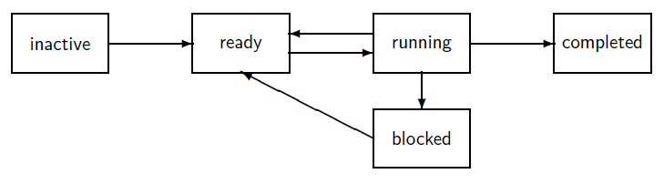
Process States

Slide 8
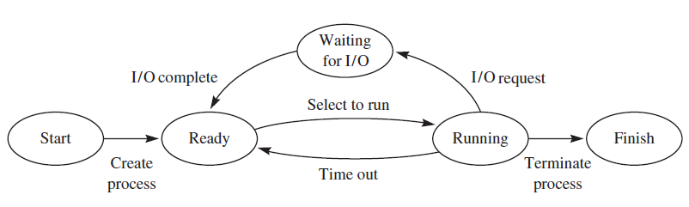
Process States

Slide 9
Definition
Semaphore S is a compound data type with two fields
Non-negative integer S.V
Set of processes in a queue S.L
A Semaphore whose integer component can take arbitrary non negative values is called a general semaphore
There are two atomic operations defined on a semaphore – wait and signal
Semaphore S must be initialized with a value of k ≥ 0 for S.V and with empty set φ for S.L

Slide 10
Initialization and Wait
Initialization
semaphore S ← (k, φ)
wait (S)
if S.V > 0
S.V ← S.V − 1
else
S.L ← S.L ∪ p
p.state ← blocked

Slide 11
Wait
If the value of integer component is non zero, decrement its value and process p can continue its execution
If it is zero, process p is added to set component and the state of the p becomes blocked
Process p is said to have been blocked on semaphore

Slide 12
Signal
signal (S)
if S.L = φ
S.V ← S.V + 1
else
Let q be some process in S.L S.L ← S.L−{q}
q.state ← ready

Slide 13
Signal
If S.L is empty, increment the value of the integer component
If S.L is non empty – unblock q an arbitrary element of the set of processes blocked on S.L.
The status of p does not change
A semaphore whose integer component can take arbitrary non negative values is called a general semaphore

Slide 14
Binary Semaphore
A semaphore whose integer component takes only the values 0 and 1 is called a binary semaphore
The value S.V is only allowed to be 0 or 1
It is also called “mutex” for mutual exclusion
Binary semaphore is initialized with (0, φ) or (1, φ)
wait (S) instruction is unchanged but signal (S) is changed

Slide 15
Wait
wait (S)
if S.V > 0
S.V ← S.V − 1
else
S.L ← S.L ∪ p
p.state ← blocked

Slide 16
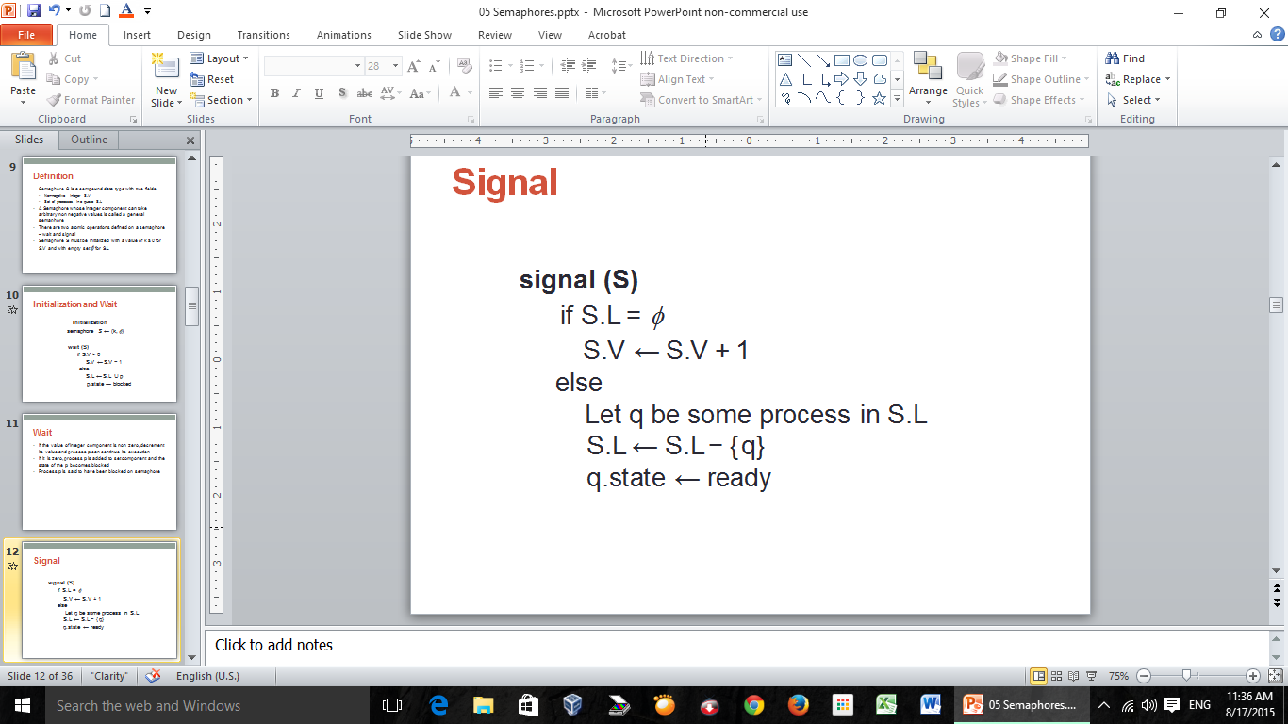
Signal
signal (S)
if S.V = 1
// undefined
else if S.L = φ
S.V ← 1
else // (as above)
let q be some process in S.L
S.L ← S.L−{q}
q.state ← ready

Slide 17
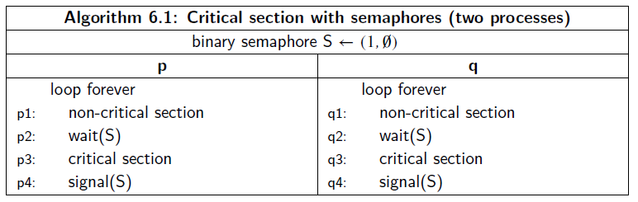
Critical Section with two Processes
The critical section problem is trivial when you have semaphores.

Slide 18
Critical Section with two Processes
A process p that wishes to enter its critical section executes a preprotocol that consists only of the wait(S) statement
If S.V=1 then S.V is decremented and p enters critical section
When p exits critical section and executes the post protocol consists of only of the signal(S) statement, the value of S will once more be set to 1

Slide 19
Critical Section with two Processes
If q attempts to enter the critical section by executing wait(S) before p has left, S.V=0 and q will become blocked on S
The value of semaphore will be (0, {q})
When p leaves the critical section and executes signal(S), the arbitrary process in the S.L = {q} will be q, so that the process will be unblocked and proceed into its critical section
The solution is similar to the Second Attempt except that
the interleaving between test and assignment is prevented
definition of semaphore operations as atomic statements

Slide 20
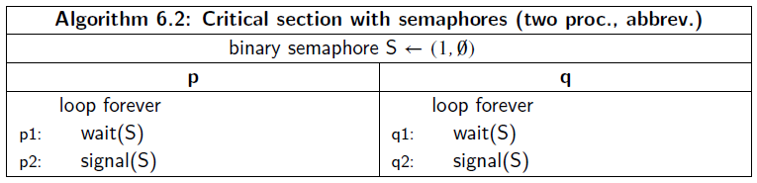
Abbreviated Form

Slide 21
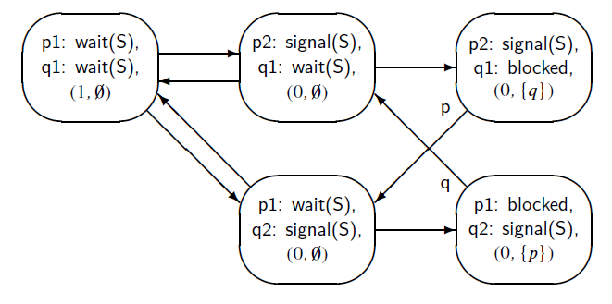
State Diagram

Slide 22
Correctness Specifications
A violation of the mutual exclusion requirement would be a state of the form (p2: signal(S), q2: signal(S), …)
No such state exists
There is no deadlock as there are no states in which both processes are blocked
The algorithm is free from starvation since if a process executes its wait statement, it enters either a state with the signal statement or it enters a state in which it is blocked
The only way out of a blocked state is into a state in which the blocked process continues with the signal statement

Slide 23
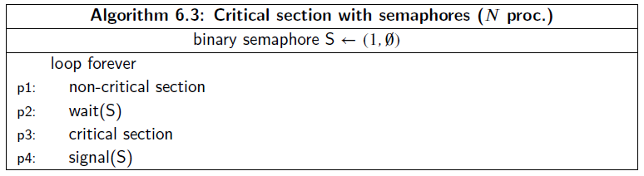
Critical Section with N processes
The same algorithm gives the solution for CS problem for N processes using semaphores:

Slide 24
Critical Section with N processes
Mutual exclusion and Freedom from deadlock holds for N processes
Freedom for starvation does not hold
Consider the abbreviated algorithm:

Slide 25
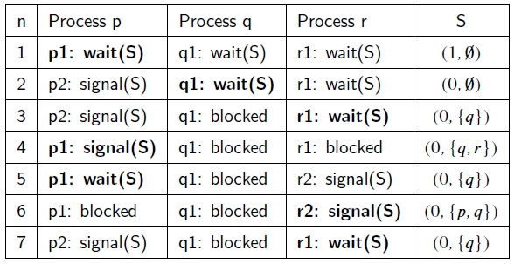
Scenario for Starvation

Slide 26
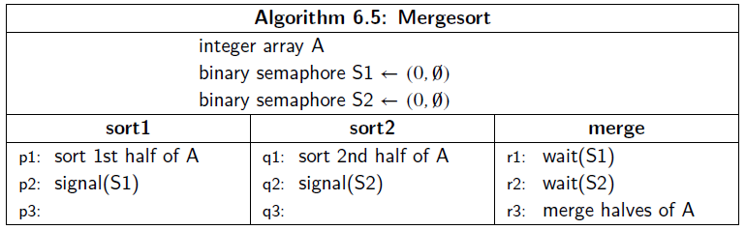
Order of Execution
Synchronization problems are also common when processes coordinate the order of execution of operations of different processes.
Uses a split binary semaphore (discussed later)

Slide 27
Types of Semaphores
Several different types of semaphores
The differences are due to the specification of liveness properties
They do not affect the safety properties that follow from the semaphore invariants, so any definition we use does not affect the mutual exclusion

Slide 28
Types of Semaphores
Strong Semaphore:
Weak semaphore has S.L, a set of processes blocked on semaphore S
This is replaced by a queue to become a strong semaphore
wait (S)
if S.V > 0
S.V ← S.V − 1
else
S.L ← append (S.L,p)
p.state ← blocked
signal (S)
if S.L = φ
S.V ← S.V + 1
else
q ← head (S.L)
S.L ← tail (S.L)
q.state ← ready

Slide 29
Types of Semaphores
Busy-Wait Semaphore:
It does not have a component S.L and S is identified only by S.V
Busy-Wait Semaphores are appropriate in a multi processor system where the waiting process has its own processor and is not wasting CPU time that could be used for other computation
wait (S)
await S > 0
S ← S − 1
signal (S)
S ← S + 1

Slide 30
Producer Consumer Problem
Producers: Producer process executes a statement produce to create a data element and then sends this element to the consumer process
Consumers: Upon receipt of the data element from the producer processes, a consumer process executes a statement consume with the data element as a parameter
Communication can be synchronous or asynchronous

Slide 31
Producer Consumer Problem
Asynchronous communication involves a channel which has some capacity for storing elements
The store is a queue of elements called a buffer
Producer executes an append operation to place a data element on the tail of the queue
Consumer executes a take operation to remove a data element from the head of the queue
The use of buffer is to allow processes of average similar speeds to proceed smoothly
Buffer can also be used to resolve a clash in the structure of data

Slide 32
Dining Philosophers Problem
Classical problem in field of concurrent programming
Sufficiently simple to be tractable yet subtle enough to be challenging
The problem is set in a secluded community of five philosophers who engage in only two activities – thinking and eating
Meals are taken communally at a table set with five plates and five forks with a bowl of spaghetti that is endlessly replenished

Slide 33
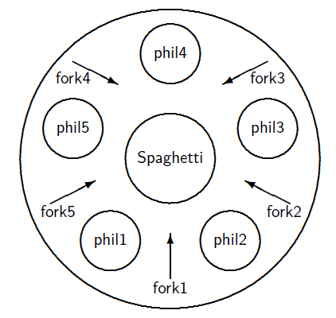
Dining Philosophers Problem

Slide 34
Dining Philosophers Problem
Philosopher needs two forks in order to eat
Each philosopher may pick up the forks on his left and right but only one at a time
The problem is to design pre and post protocols to ensure that a philosopher only eats if she has two forks
Solution should satisfy the correctness properties

Slide 35
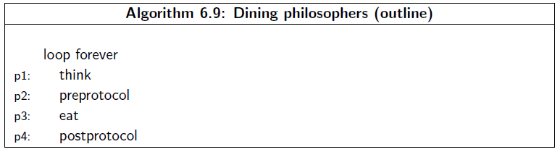
Dining Philosophers Problem

Slide 36
Readers Writers Problem
Similar to Mutex problem where several processes are competing for access to a critical section
Readers are processes which require to exclude writers but not other readers
Writers are processes which require to exclude both readers and other writers
Several processes can read data concurrently, but writing or modifying data must be done under Mutex to ensure consistency of Data

Slide 37
Producer Consumer Problem
Two Synchronization issues:
Consumer cannot take data from an empty buffer
Producer cannot append a data element to a full buffer as the buffer size is finite
We consider buffer can be infinite or bounded to devise a solution

Slide 38
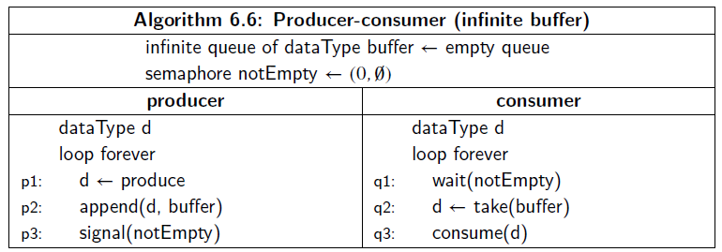
Infinite Buffer
If there is an infinite buffer, there is only one interaction that must be synchronized: consumer must not attempt a take operation from an empty buffer

Slide 39
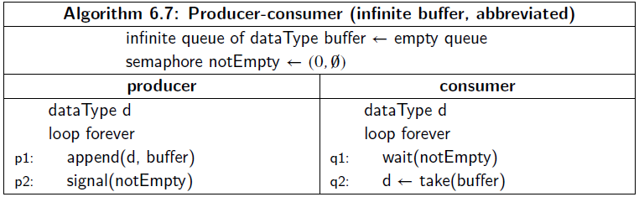
Infinite Buffer - Abbreviated
As buffer is infinite, it is impossible to construct a finite state diagram for the algorithm

Slide 40
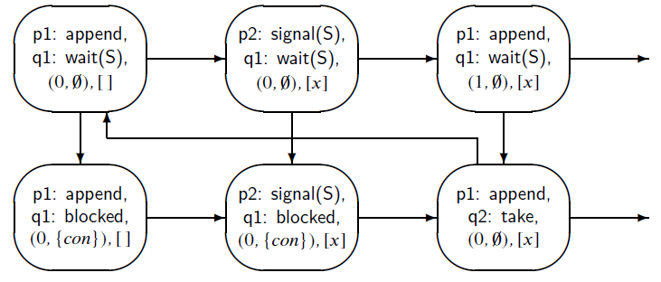
Infinite Buffer – State Diagram
Value of buffer is written with square brackets and a buffer element is denoted by x, consumer process is denoted by con.
Horizontal rows indicate execution of operations by the producer while vertical rows are for the consumer

Slide 41
Infinite Buffer - Correctness
Consumer does not remove an element from an empty buffer
Algorithm is free from deadlock – because – as long as producer continues to produce data elements, it will execute signal(notEmpty) operations and unblock the consumer
It is also free from starvation as there is only one possible blocked process

Slide 42
Bounded Buffer
The algorithm for producer-consumer problem with an infinite buffer can be easily extended to one with a finite buffer
Producer takes empty places from a buffer just as the consumer takes data elements from the buffer
We use a similar synchronization mechanism with a semaphore notFull that is initialized to N, the number of initially empty spaces in the finite buffer.

Slide 43
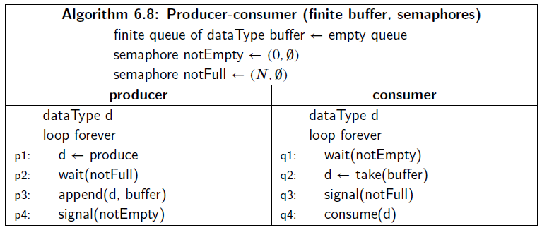
Bounded Buffer

Slide 44
Split Semaphore
The previous algorithm uses a technique called Split Semaphore
This is not a new Semaphore type but simply a term used to describe a synchronization mechanism built from semaphores.
A split semaphore is a group of two or more semaphores satisfying an invariant that the sum of their values is at most equal to a fixed number N.
notEmpty + notFull = N
In case if N=1, its called a split binary semaphore
Split semaphores enable one process to wait for the completion of an event in another

Slide 45
Dining Philosophers Problem
Classical problem in field of concurrent programming
Sufficiently simple to be tractable yet subtle enough to be challenging
The problem is set in a secluded community of five philosophers who engage in only two activities – thinking and eating
Meals are taken communally at a table set with five plates and five forks with a bowl of spaghetti that is endlessly replenished

Slide 46
Dining Philosophers Problem

Slide 47
Dining Philosophers Problem

Slide 48
Dining Philosophers Problem
Philosopher needs two forks in order to eat
Each philosopher may pick up the forks on his left and right but only one at a time
The problem is to design pre and post protocols to ensure that a philosopher only eats if she has two forks
Solution should satisfy the correctness properties

Slide 49
Correctness Properties
A philosopher can eat only if she has two forks
Mutual Exclusion: No two philosophers may hold the same fork simultaneously
Freedom from deadlock
Freedom from starvation
Efficient behavior in the absence of contention

Slide 50
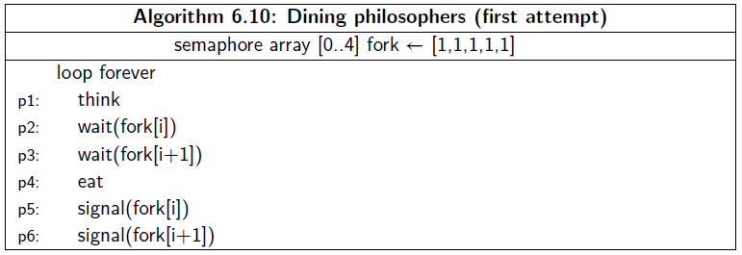
Dining Philosophers – First Attempt
We assume that each philosopher is initialized with its index i, and that addition is implicitly modulo 5.
Each fork is modelled as a semaphore: wait corresponds to taking a fork and signal corresponds to putting down a fork
Philosopher hold both forks before eating

Slide 51
Dining Philosophers – First Attempt
This solution deadlocks under an interleaving that has all philosophers pick up their left forks – execute wait (fork[i]) – before any of them tries to pick up a right fork
All are waiting for a right fork and no process will execute a single instruction

Slide 52
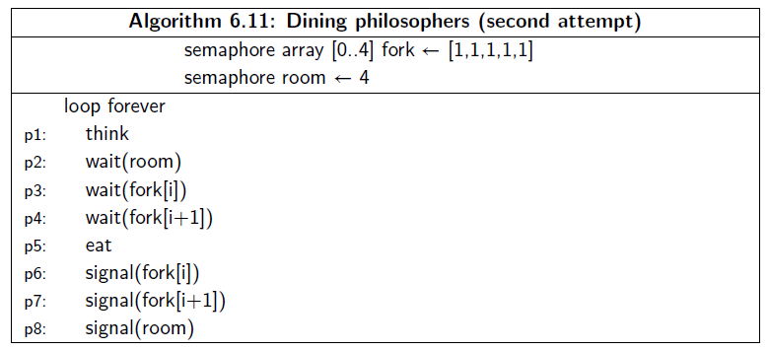
Dining Philosophers – Second Attempt
One way to ensure a liveness in a solution to the dining philosophers problem is to limit the number of philosophers entering the room to four

Slide 53
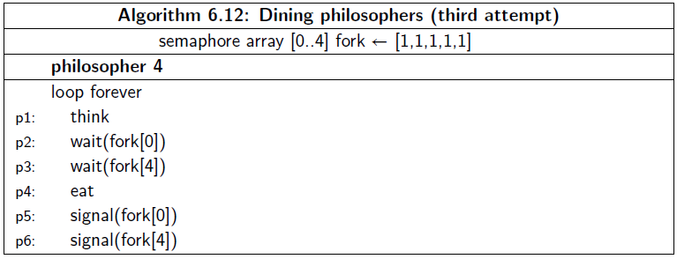
Dining Philosophers – Third Attempt
Another solution that is free from starvation is an asymmetric algorithm which has first four philosophers execute the original solution but the fifth philosopher waits first for the right fork and then for the left fork

Slide 54
Possible Solutions
Use a waiter
Execute different code for odd/even
Give them another chopstick
Allow at most 4 philosophers at the table
Randomized (Lehmann-Rabin)

Slide 55
Reader’s Writer’s Problem
A data structure is shared among a number of concurrent processes:
Readers – Only read the data; They do not perform updates.
Writers – Can both read and write.
Problem
Allow multiple readers to read at the same time.
Only one writer can access the shared data at the same time.
If a writer is writing to the data structure, no reader may read it.

Slide 56
First Solution
Shared Data:
The data structure
Integer readcount initialized to 0.
Semaphore mutex initialized to 1.
Protects readcount
Semaphore write initialized to 1.
Makes sure the writer doesn’t use data at the same time as any readers

Slide 57
First Solution
The structure of a writer process:
while (true) {
P (write) ;
writing is performed
V (write) ;
}

Slide 58
First Solution – Readers have Priority
The structure of a reader process:
while (true) {
P (mutex) ;
readcount ++ ;
if (readcount == 1)
P (write) ;
V (mutex)
reading is performed
P (mutex) ;
readcount - - ;
if (readcount == 0)
V (write) ;
V (mutex) ;
}

Slide 59
First Solution – Readers have Priority
The structure of a reader process:
while (true) {
P (mutex) ;
readcount ++ ;
if (readcount == 1)
P (write) ;
V (mutex)
reading is performed
P (mutex) ;
readcount - - ;
if (readcount == 0)
V (write) ;
V (mutex) ;
}
This solution is not perfect:
What if a writer is waiting to write but there are readers that read all the time?
Writers are subject to starvation!

Slide 60
Second Solution – Writer Priority
Extra semaphores and variables:
Semaphore read initialized to 1 – restrains readers when a writer wants to write.
Integer writecount initialized to 0 – counts waiting writers.
Semaphore write_mutex initialized to 1 – controls the updating of writecount.
Semaphore mutex now called read_mutex
Queue semaphore used only in the reader

Slide 61
Second Solution – Writer Priority
The writer:
while (true) {
P(write_mutex)
writecount++; //counts number of waiting writers
if (write_count ==1)
P(read)
V(write_mutex)
P (write) ;
writing is performed
V(write) ;
P(write_mutex)
writecount--;
if (writecount ==0)
V(read)
V(write_mutex)
}

Slide 62
Second Solution – Writer Priority
The reader:
while (true) {
P(queue)
P(read)
P(read_mutex) ;
readcount ++ ;
if (readcount == 1)
P(write) ;
V(read_mutex)
V(read)
V(queue)
reading is performed
P(read_mutex) ;
readcount - - ;
if (readcount == 0)
V(write) ;
V(read_mutex) ;
}
Queue semaphore, initialized to 1:
Since we don’t want to allow more than one reader at a time in this section (otherwise the writer will be blocked by multiple readers when doing P(read). )

Slide 63
